Slide 1

Sales Data Analytics
Work Report - 苏泽
November 22, 2022
Mamadou Alpha Diallo
苏泽 210854002053

Slide 2

01 The Data
02 Basic Analysis and Visualizations
03 Productline prediction
04 Conclusion
目录
CONTENTS

Slide 3
01 The Data
02 Basic Analysis and Visualizations
03 Productline prediction
04 Conclusion
目录
CONTENTS

Slide 4
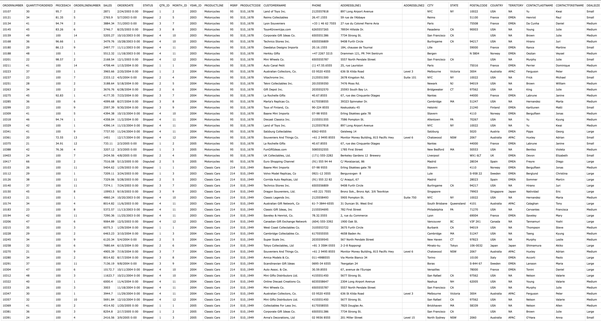
01 - Data
Notes:
Sample Sales Data, Order Info, Sales, Customer, Shipping, etc., Used for Segmentation, Customer Analytics, Clustering and More. Inspired for retail analytics. This was originally used for Pentaho DI Kettle, But I found the set could be useful for Sales Simulation training.
Originally Written by María Carina Roldán, Pentaho Community Member, BI consultant (Assert Solutions), Argentina. This work is licensed under the Creative Commons Attribution-Noncommercial-Share Alike 3.0 Unported License. Modified by Gus Segura June 2014.

Slide 5
01 The Data
02 Basic Analysis and Visualizations
03 Productline prediction
05 Conclusion
目录
CONTENTS

Slide 6

02 - Basic Analysis and Visualizations

Slide 7
01 The Data
02 Basic Analysis and Visualizations
03 Productline prediction
05 Conclusion
目录
CONTENTS

Slide 8
03 - Productline analysis and Visualizations

Slide 9
临沂大学 - 信息科学与工程学院 - SBA研究组
Thanks for your attention!
谢谢!

